Slide 1
Supervised by:
Enhancing Binary Particle Swarm Optimization for Graph Coloring Problem
Presented by:
Md Younos
Student ID: 194028
Mizanur Rahman
Student ID: 194053
Md.Osman Goni
Student ID: 194054
Dr. Md. Jakirul Islam
Associate Professor
Department of Computer Science and Engineering
Dhaka University of Engineering & Technology, Gazipur

Slide 2
Outline
Introduction
Aims
Objective
Methodology
Proposed Research Plan
Conclusion

Slide 3
Introduction
Graph coloring is a classic NP-hard optimization problem with applications in scheduling, resource allocation, and network design.
The Graph Coloring Problem is a challenging optimization task with practical relevance.

Slide 4
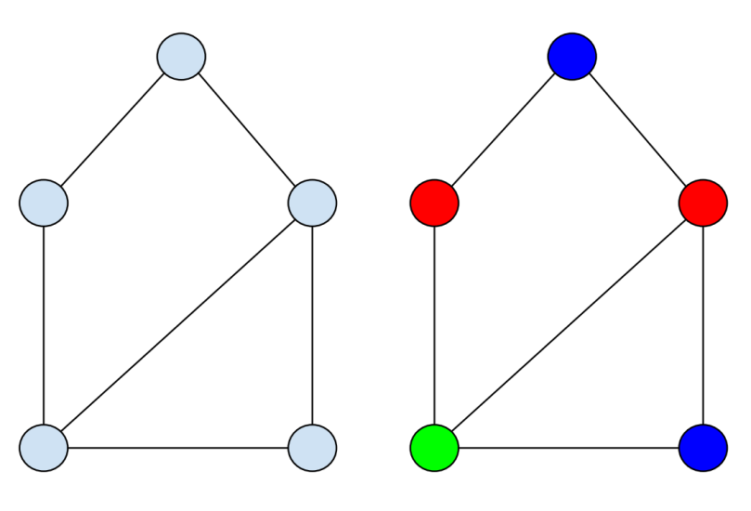
Introduction
The Graph Coloring Problem involves assigning colors to the vertices of a graph in such a way that no adjacent vertices share the same color. The objective is to minimize the number of colors used.
Figure: Non-colored and colored graph

Slide 5
Aims
The research aims to develop novel strategies and modifications to the traditional BPSO algorithm, addressing the specific challenges posed by Graph Coloring Problem.
To minimize the chromatic number.
To evaluate the efficiency and effectiveness of graph coloring solutions.

Slide 6
Objective
To improve the binary encoding scheme used by BPSO to represent and manipulate graph coloring solutions more effectively.
To integrate a local search mechanism within the BPSO algorithm to refine solutions and enhance the convergence speed.
Evaluate and compare performance of the modified BPSO algorithm.

Slide 7
Methodology
Initially, we will gather varied datasets from multiple sources.
Subsequently, we will implement the existing algorithms for GCP. Following this, we will modify the existing BPSO by adapting local search mechanism to improve its performance.
Later, we will assess the performance of the original BPSO and our modified BPSO algorithm, followed by a comparative analysis.

Slide 8
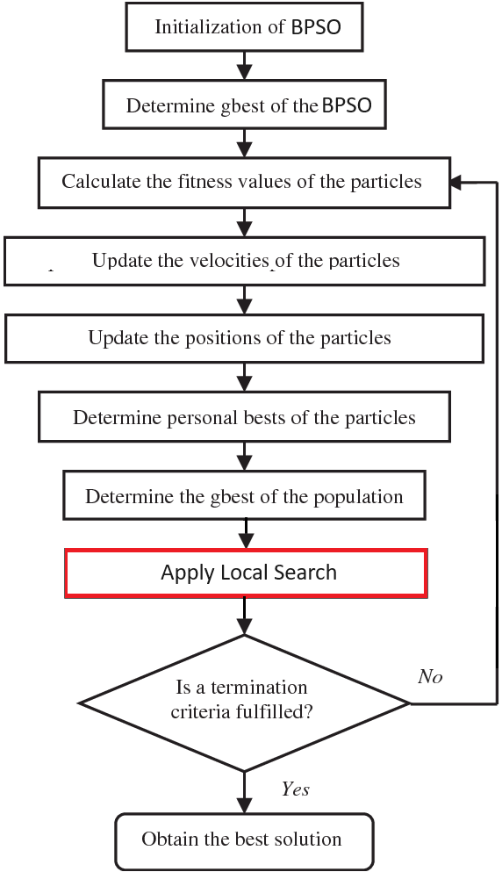
Methodology
Figure: The flowchart of the modified BPSO algorithm

Slide 9
Proposed Research Plan
Stages of research | Jan-23 to Mar-23 | Apr-23 to Jun-23 | Jul-23 to Sep-23 | Oct-23 to Dec-23 | Jan-24 to Mar-24 | Apr-24 to Jun-24
Selection of topic
Literature review
Research methodology plan
Selection of the Appropriate Research Techniques
Analysis & Interpretation of Data
Findings and recommendations
Final research project

Slide 10
Conclusion
This proposal outlines a research plan to enhance Binary Particle Swarm Optimization for the Graph Coloring Problem.
The proposed modifications aim to address the specific challenges of the GCP and contribute to the development of more effective optimization algorithms for combinatorial problems.

Slide 11
References
T. R. Jensen and B. Toft, "Graph coloring problems," John Wiley & Sons, Oct. 24, 2011.
M. Kubale, "Introduction to computational complexity and algorithmic graph coloring," Gdanskie Towarzystwo Naukowe, 1998.
F. Mascia, "DIMACS Maximum Clique Benchmarks," IRIDIA - ULB (Université Libre de Bruxelles). Available: https://iridia.ulb.ac.be/~fmascia/maximum_clique/DIMACS-benchmark. Access date: Jul. 12, 2023.
S. Shah, "GCLIQUE: An Open Source Genetic Algorithm for the Maximum Clique Problem," Authorea Preprints, Sep. 26, 2023.
M. Hasan, M. R. Islam, and A. G. Mugdha, "Solving maximum clique problem using chemical reaction optimization," OPSEARCH, Jun. 20, 2023, pp. 1-37.
E. Pelofske, G. Hahn, and H. N. Djidjev, "Solving larger maximum clique problems using parallel quantum annealing," Quantum Information Processing, vol. 22, no. 5, May 16, 2023, pp. 219.
B. Q. Pinto, C. C. Ribeiro, I. Rosseti, and A. Plastino, "A biased random-key genetic algorithm for the maximum quasi-clique problem," European Journal of Operational Research, vol. 271, no. 3, Dec. 16, 2018, pp. 849-865.
D. B. Fontes, J. F. Goncalves, and F. A. Fontes, "An evolutionary approach to the maximum edge weight clique problem," Recent Advances in Electrical & Electronic Engineering (Formerly Recent Patents on Electrical & Electronic Engineering), vol. 11, no. 3, Sep. 1, 2018, pp. 260-266.

Slide 12


